Slide 1



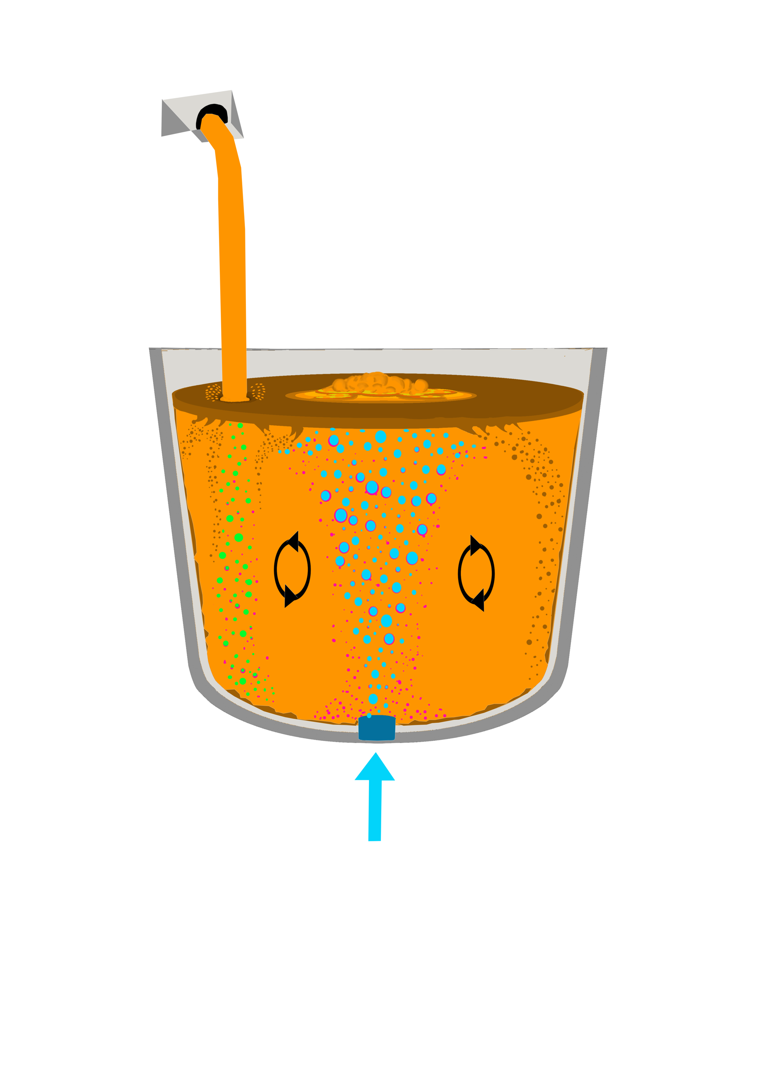
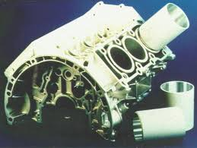
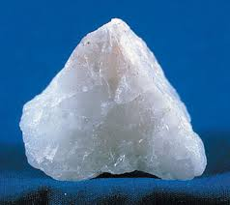
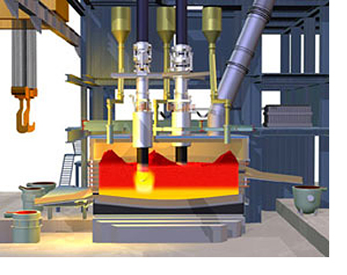
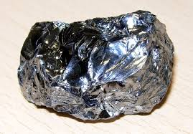


Silicon Production and Refining
Short Course, 4-7 October 2021
Norwegian University of Science and Technology

Slide 2
General Information
Held as an intensive 4 day course
Hybrid participation (Trondheim and on-line)
Free of charge
The course is suitable for both industry and MSc/PhD level students
Held as partial fulfilment of courses TMT4306 and TMT4326 at NTNU
Joint arrangement NTNU-SFI Metal Production-EIT RM SisAl Slag Value and FME Susoltech
Lecturers from NTNU, SINTEF and Industry

Slide 3
Program Day 1+ 2
Aspects of Si Production

Slide 4
Program Day 3+ 4
Aspects of Si Refining

Slide 5
Registration
Register on the following link by 1st October at the latest!
https://forms.office.com/r/mUtNNmjQLi
Questions:
  gabriella.tranell@ntnu.no
  merete.tangstad@ntnu.no
  maria.wallin@ntnu.no

